Slide 1
Aerospace Composites Industry Market Shares ($ billions)*
CAGR: 6%
$3.95B
$5.29B
Source: company filings; author analysis and estimates
* 2019 USD/JPY conversion rate: 107.84; USD/EUR conversion rate: 0.93. For 2014, USD/JPY is 105.74
† Solvay did not have carbon composites business segment in 2014. However, Solvay acquired Cytec in 2015

Slide 2
1996: Acquired Ciba Composites and Hercules Composites Products Division
2017: Acquired Oxford Performance Materials A&D Business and Structil SA
2019: Boeing 737 Max grounded due to a flaw design in the MCAS system
Founded in 1948 by a group of engineers from UC Berkeley
1969: the landing pads on Apollo 11 were built by Hexcel
1997: acquired Fiberite’s satellite prepreg business
2019: acquired ARC Tech to expand into RF absorbing material technologies
1H 2020: suspended dividends, execs pay halved, RIF, unpaid furlough, reduced capex; Woodward merger terminated

Slide 4
Recessionary Analysis - CM 2015 - 2011

Slide 5
Recessionary Analysis - EP 2015 - 2011

Slide 6
CM
EP

Slide 7
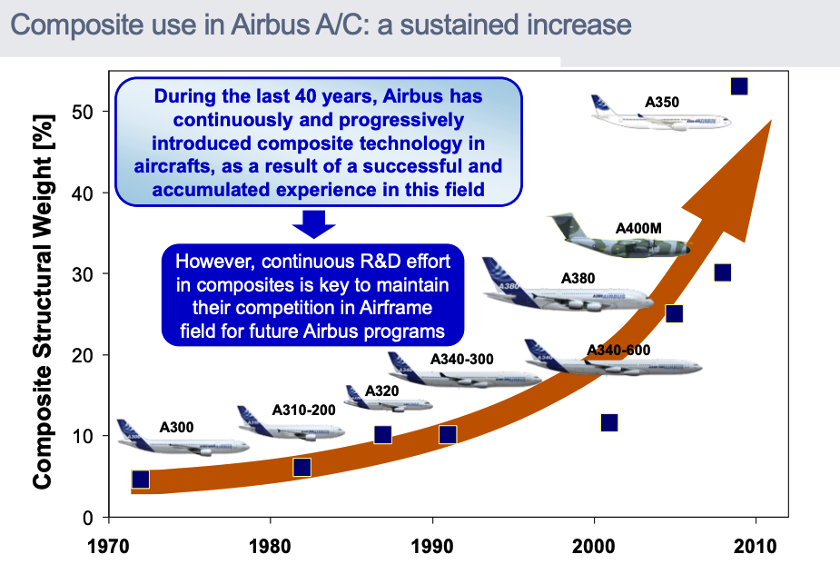

Slide 8
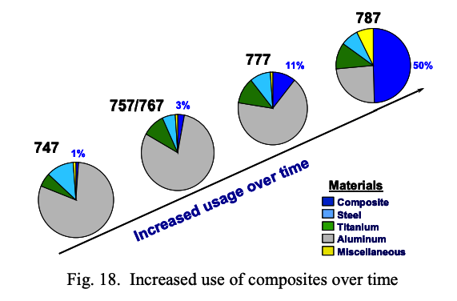

Slide 9
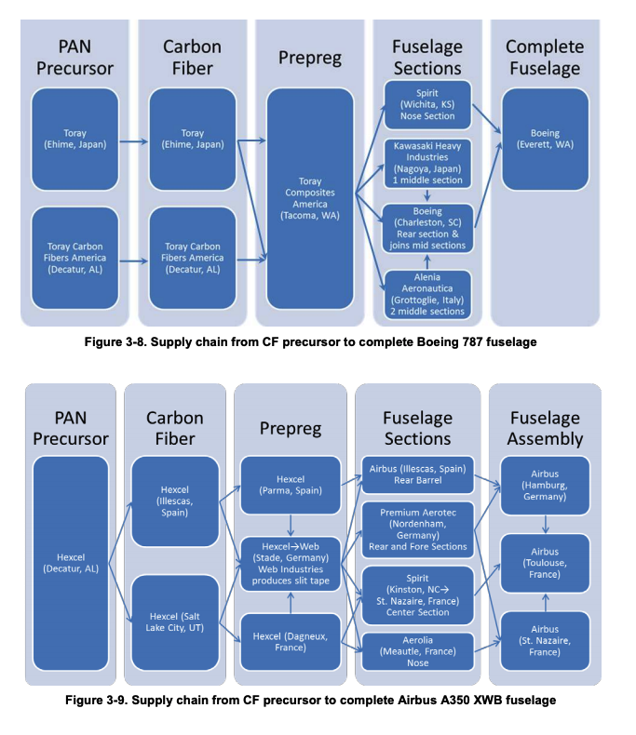
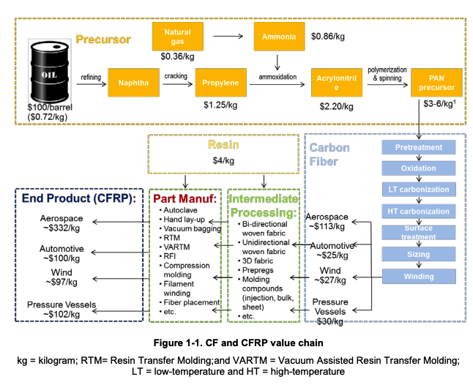
Notes:
Source: Global Carbon Fiber Composite Supply Chain Competitiveness Analysis

